Slide 1
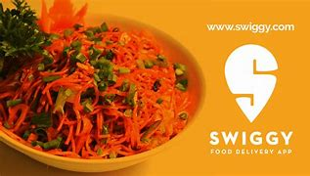
Swiggy Business Analysis

Slide 2
AAYUSH KATARIA
Team Members
ANJALI BAKSHI
MAASAHHEBI USTAAD
MANIKYAM SOMESHWAR

Slide 3

INTRODUCTION
Swiggy, founded in 2014, is a major Indian online food delivery platform headquartered in Bangalore. It operates across 500+ cities in India. Apart from food delivery, Swiggy offers Instamart for groceries and Swiggy Genie for package delivery. It competes with Zomato in food delivery and hyper-local markets.

Slide 4
OBJECTIVES
Data Collection & Processing:
Scrape diverse Swiggy data: restaurant info, user ratings, cuisine preferences, reviews, and locations.
Algorithm Design:
Design algorithm to generate personalized recommendations based on past ratings, cuisine preferences, delivery review number and location.
Webpage Development:
Build user-friendly webpage for recommendations. Include search, menus, reviews, and ratings
.
Restaurant Insights:
Aid potential restaurant owners with cuisine offerings and pricing.
Assisting potential restaurant owners in determining optimal cuisine offerings and average pricing for new restaurant ventures.

Slide 5
PURPOSE
Delivers tailored restaurant suggestions to cater to individual preferences.
Promotes user exploration, benefiting restaurant partners' business.
Cuts down user effort in discovering new dining choices.
Streamlines restaurant selection, enhancing user convenience.
Enhances user satisfaction and engagement.
Aligns services with customer preferences and market trends.

Slide 6
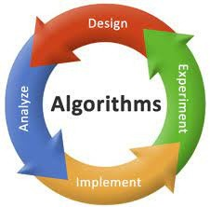
Techniques Implemented
Web scrapping using Beautiful soup & Selenium
Data Cleaning using Excel, Data Processing using pandas
Model Building using Different Machine Learning Algorithms
Web Page Building using Streamlit Library and Basic CSS

Slide 7
Machine Learning models
Transformed Categorical data into Continuous by utilizing Label Encoder and One-Hot Encoder for effective encoding.
Utilized Linear Regression, Logistic Regression and some other models to forecast the Estimated Price for an item, Location and cuisine of the Restaurant.
Achieved a remarkable accuracy score with the Linear Regression, whereas the Logistic Regression Model and Random Forest exhibited a modest accuracy .

Slide 8
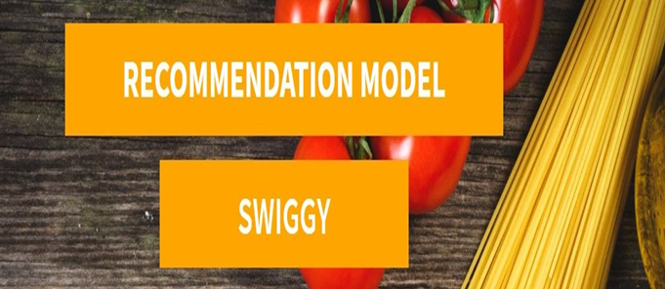
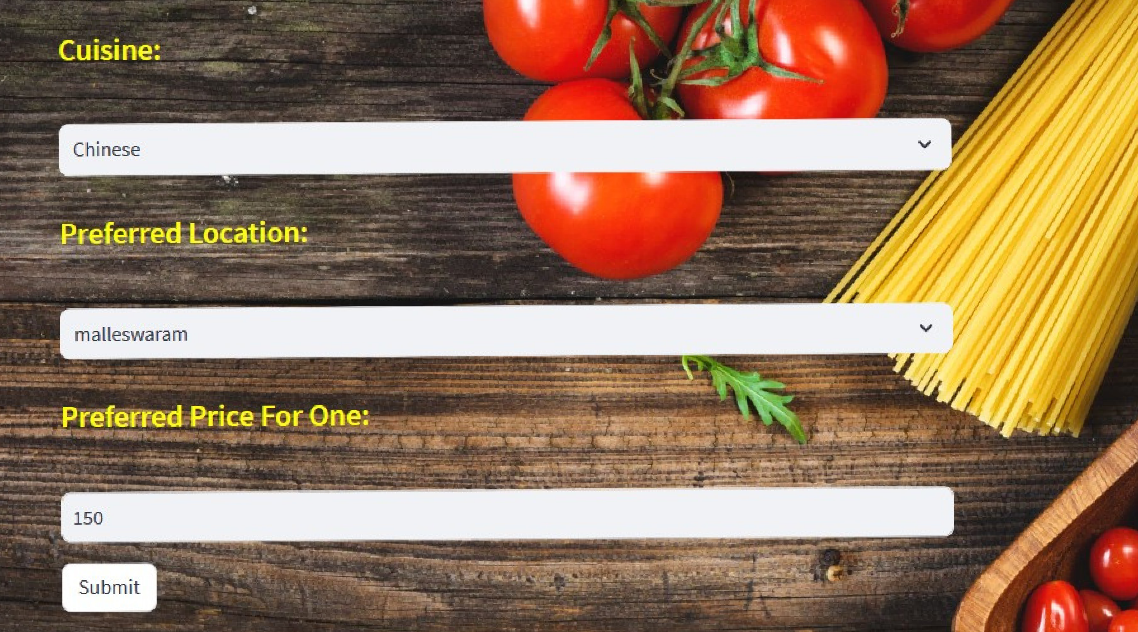
Web Page

Slide 9
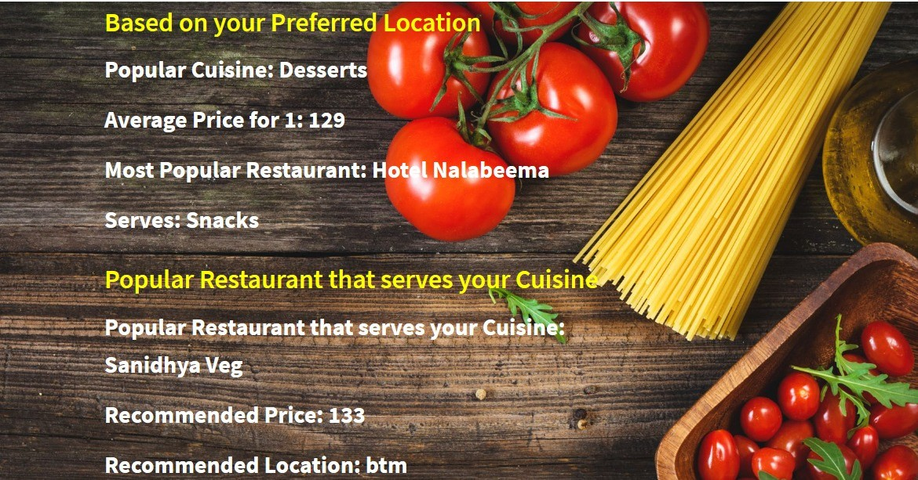
Output

Slide 10
Limitations and Future work
Limited Data (Not good sample): The system faces difficulty in delivering accurate recommendations due to insufficient data about users and items
Solution: Extracting data from alternate data sources can enhance recommendation quality by providing a broader view of user preferences and item characteristics.
2. Real Time update Challenges: Incorporating real-time updates, such as new user preferences or changes in item availability, is challenging.
Solution: Implement mechanisms to adapt and update recommendations in real-time, ensuring the system remains up-to-date and responsive to user dynamics.

Slide 11

Challenges
Model Accuracy
Web Scrapping
Styling & Integrating Web Page

Slide 12

LEARNING OUTCOMES
Explore model selection, evaluation metrics, and their relevance to delivery predictions
Streamlit Python library
Deploying Machine Learning Models on a Webpage Fundamental Understanding of CSS
Web Data Scraping Effective Management
Collaborative Teamwork and Coordination

Slide 13

Thank You

